Slide 1

JusLearn
A Cloud-Based E-Learning Platform Leveraging Core AWS Services
Radhanjan Neelamraju (23BCI0126) | Ramasani Vishwas Sai (23BCI0118)
BCSE355L - Cloud Architecture Design | Supervisor: Dr. Yoganand S.

Slide 2


Abstract: The Project Goal
What is JusLearn?
Primary Objective
JusLearn is a prototype web application demonstrating a fundamental 3-Tier Architecture deployed on Amazon Web Services (AWS).
To showcase the practical integration of core AWS components to build a functional, resilient, and database-driven e-learning solution.
It allows students to access Computer Science content (OS, DBMS, CN), track their progress, and upload assignments.
It addresses the challenge of providing a scalable and highly available architecture for educational content.

Slide 3
Introduction & Motivations
The Background: The E-Learning market is a multi-billion dollar industry. Traditional platforms face challenges in scalability, reliability, and security for specialized technical content.
Centralization: To solve the need for a single, centralized, and accessible hub for core Computer Science subjects (OS, DBMS, CN).
Cloud Proficiency: To create a tangible prototype demonstrating the practical integration of core AWS services: EC2 (Compute), S3 (Storage), and Security Groups (Networking).
Security & Data: To implement secure practices like bcrypt password hashing and provide tools for tracking topic completion through a centralized database.

Slide 4


Project Scope
Architectural Scope
Functional Scope
•
Model: A classic 3-Tier Architecture.
•
Courses: Operating Systems, DBMS, & Computer Networks.
•
Services: Amazon EC2, Amazon S3, and VPC/Security Groups.
•
Auth: Secure Sign Up & Sign In with `bcrypt` hashing.
•
Security: Network access is limited to Port 22 (SSH) and Port 5000 (API).
•
Features: Video/PDF content delivery, database-driven progress tracking, and assignment uploads.
•
Data: Prototype uses SQLite on EC2, architected for future migration to Amazon RDS.

Slide 5
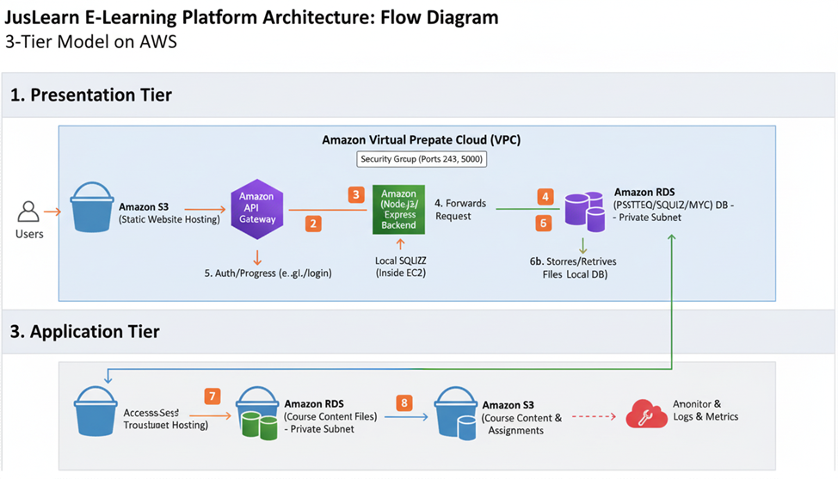
System Architecture: 3-Tier Model
JusLearn uses a 3-Tier Architecture for security, scalability, and maintenance.
1. Presentation Tier (S3)
Hosts all static files (HTML, CSS, JS) via S3 Static Website Hosting. This is what the user sees.
2. Application Tier (EC2)
Runs the Node.js/Express backend on an EC2 instance. It handles all business logic, API requests, and authentication.
3. Data Tier (SQLite/RDS)
A local SQLite database on the EC2's EBS volume provides data persistence for the prototype. Architected for future migration to Amazon RDS.

Slide 6
Integration: How S3 and EC2 Connect
4. EC2 Responds
2. Click 'Login'
The Security Group allows the request on Port 5000. Node.js queries the database and returns a response to the S3 frontend.
Browser downloads HTML/JS. User clicks 'Login' or 'Sign Up'.
1. Access S3
3. API Call
User accesses the Static Website Endpoint URL hosted on Amazon S3.
JavaScript sends a `fetch` request to the hardcoded EC2 Public IP (e.g., `http://13.60.15.255:5000/api/login`).

Slide 7






Core AWS Services Used
Amazon S3
Amazon EC2
Security Groups
Acts as the Presentation Layer. Hosts all static HTML/JS files and is configured for Static Website Hosting with a public Bucket Policy.
Acts as the Application Layer. Runs the Node.js/Express backend on a T3.micro instance, handling all business logic and API requests.
Acts as a network firewall for the EC2 instance. Restricts all access except Port 22 (SSH) for admin and Port 5000 (API) for the S3 frontend.

Slide 8


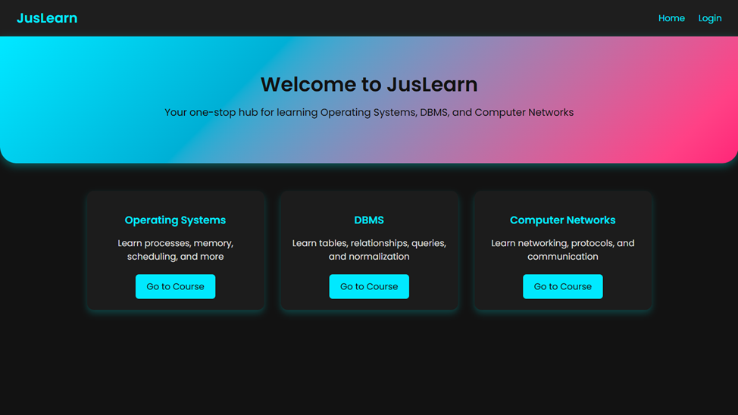
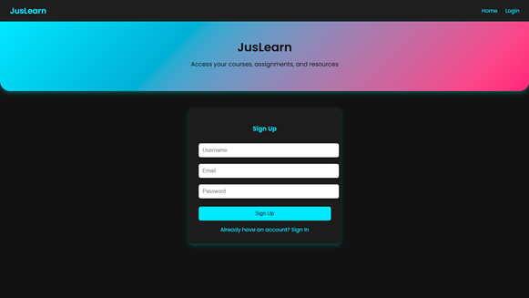
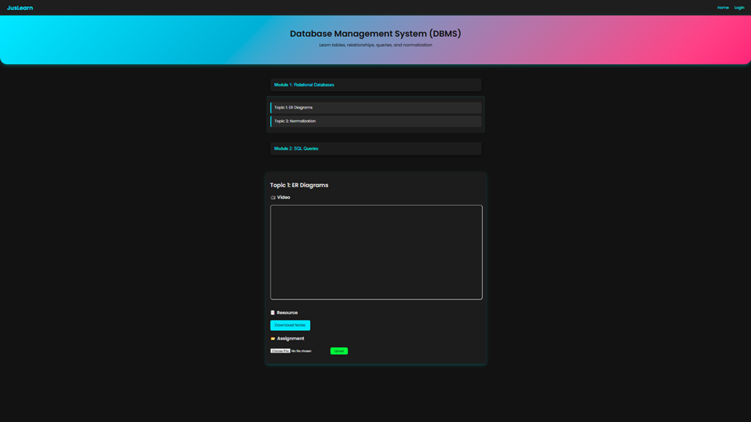
Demonstration: Application UI
Fig 8: Index Page
The main landing page (index.html) served from S3, showing the three course cards.
Fig 9: Login Page
The login/signup form, which sends API calls directly to the EC2 backend.
Fig 11: Topic Detail View
The dynamic course page showing video, resources, and the assignment upload module.

Slide 9

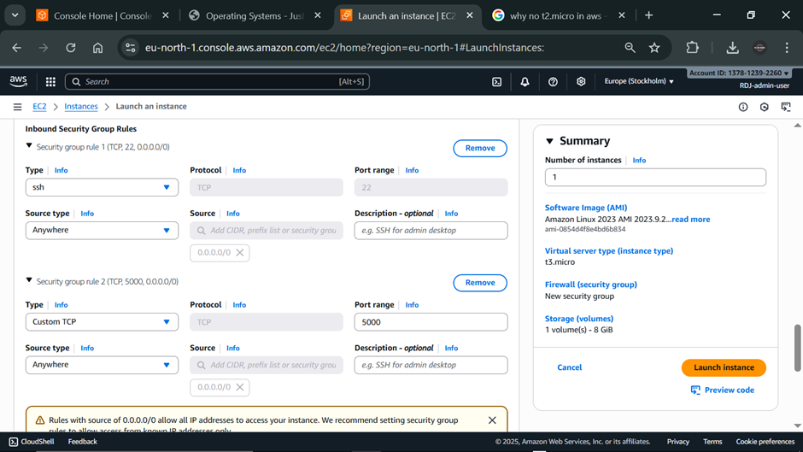
Demonstration: AWS Infrastructure
EC2 & Security Groups
The AWS console confirms the EC2 instance is live and running. The associated Security Group (Fig 4) is critical for the project's security.
It acts as a firewall, enforcing the rule that only API traffic on Port 5000 and admin traffic on Port 22 (SSH) are allowed.
This isolates the backend server from all other unwanted network access, fulfilling a core non-functional requirement.

Slide 10
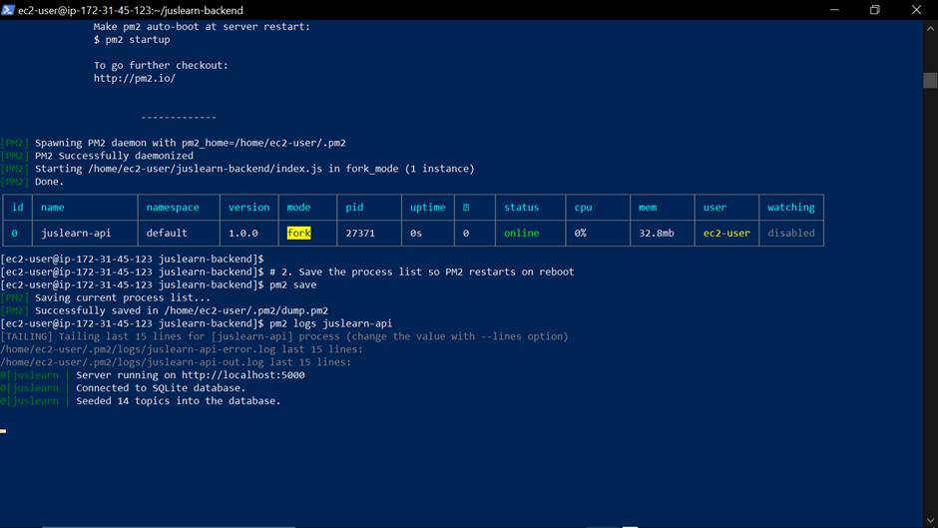
Demonstration: Server Status (PM2)
The Node.js server is deployed on the EC2 instance and managed by PM2.
PM2 runs the app as a background service, ensuring it stays online even if the SSH terminal is closed.
The logs (Fig 6) confirm the server is successfully:
•
Running on Port 5000
•
Connected to the SQLite database
•
Seeded all 14 topics into the database

Slide 11
Conclusion & Future Work
JusLearn successfully demonstrates a functional 3-Tier Web Application on AWS, validating the use of EC2, S3, and Security Groups for a secure and cost-effective cloud solution.
"
"
Future Work: The primary next step is to migrate the prototype's local SQLite database to **Amazon RDS** (Relational Database Service). This will enhance reliability, eliminate the single point of failure in the current data layer, and move the system toward full production resilience.

Slide 12
THANK YOU

